Slide 1

Motor Vehicle Crashes in Texas -2013-
DSO104 Data Wrangling and Visualization
Lesson 10 – Final Project
Melissa Gonzalez
16th July 2021

Slide 2
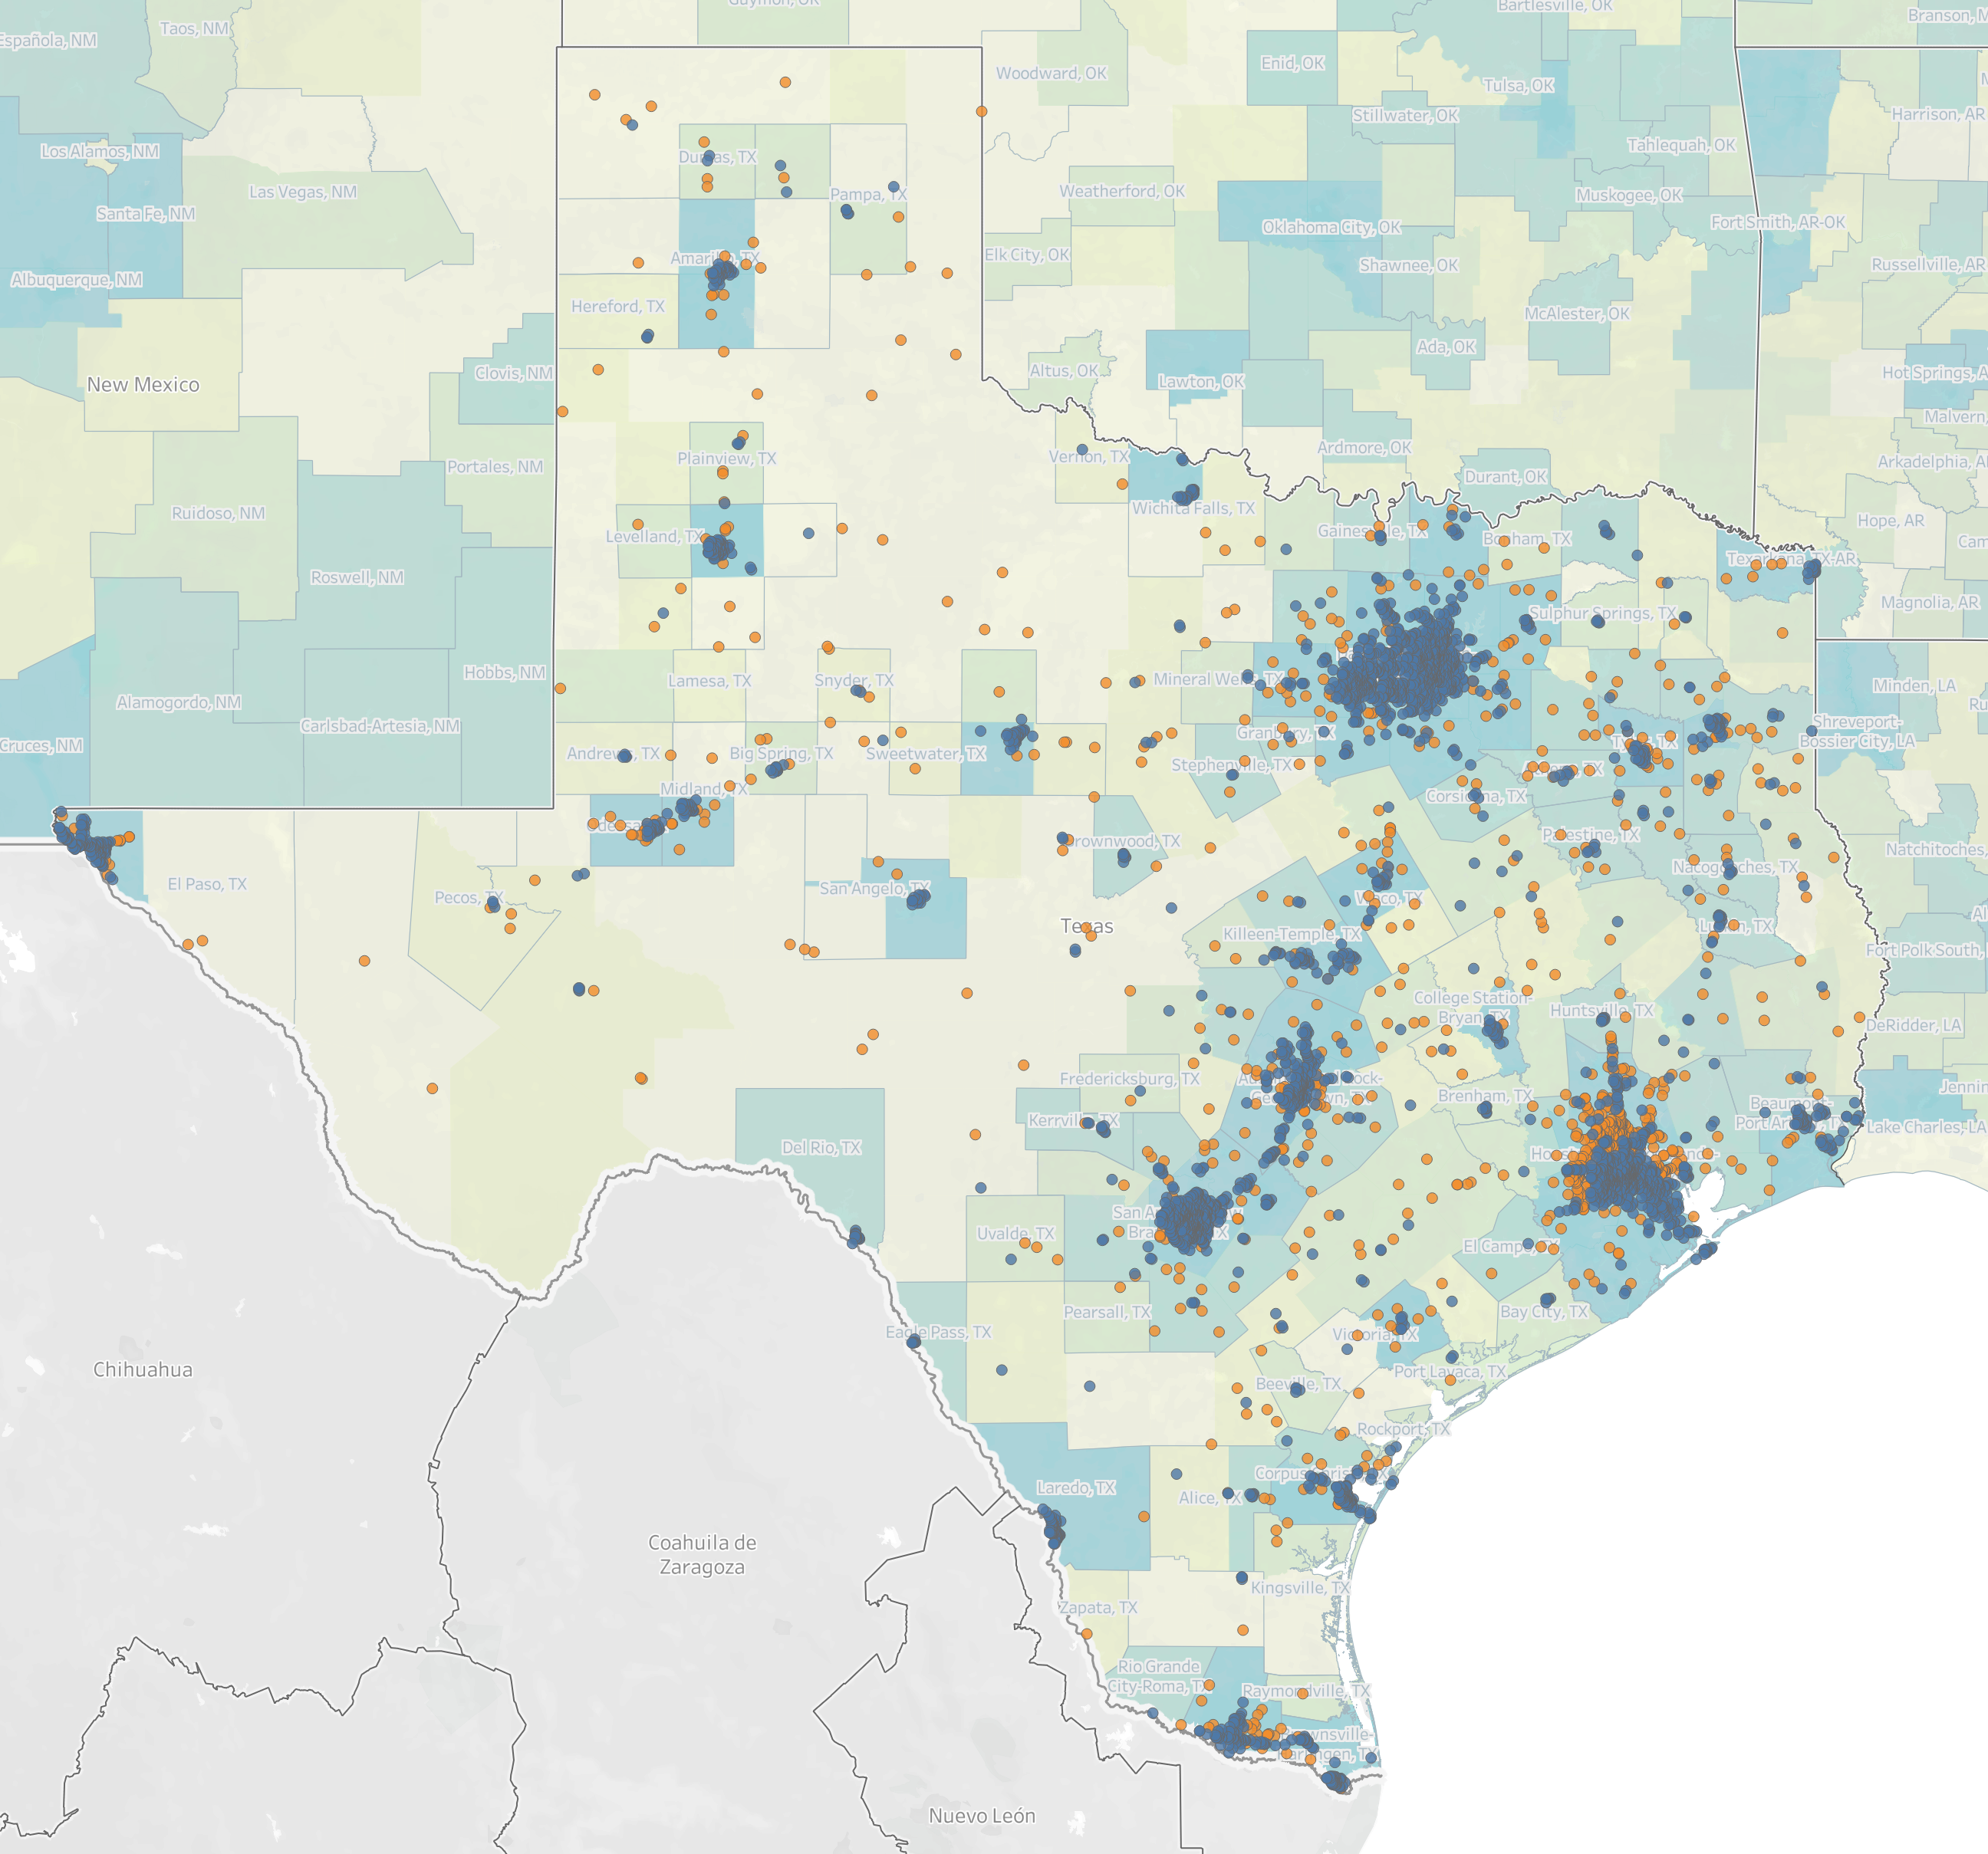
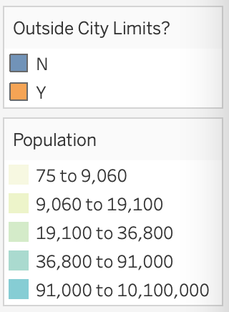
Statewide Distribution
As would be expected, the majority of reported motor vehicle collisions occurred within city limits across the state of Texas.
The larger blue areas are the largest metropolitan areas in Texas :
Dallas/Ft. Worth
El Paso
Houston
Brownsville
Austin
Armarillo
San Antonio

Slide 3
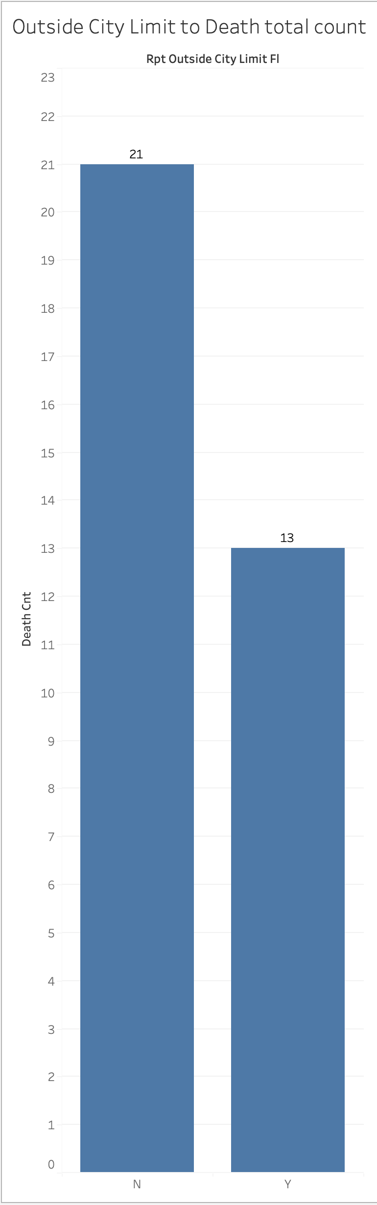
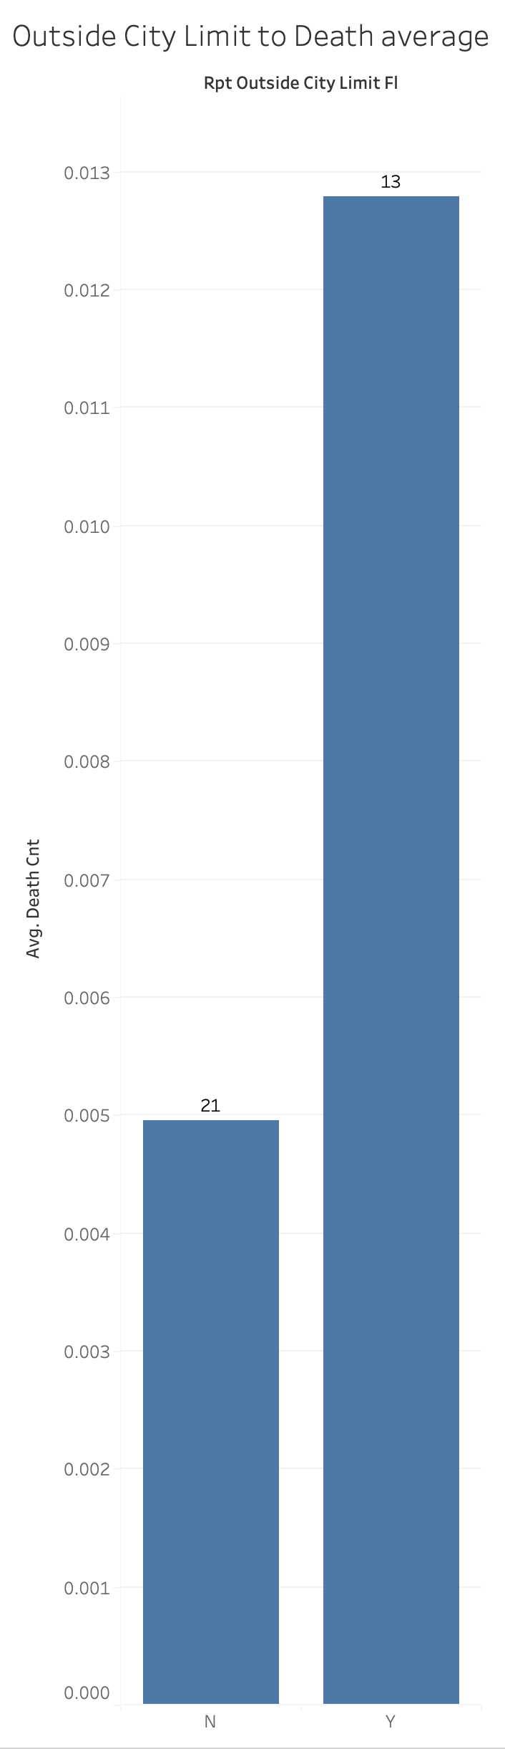
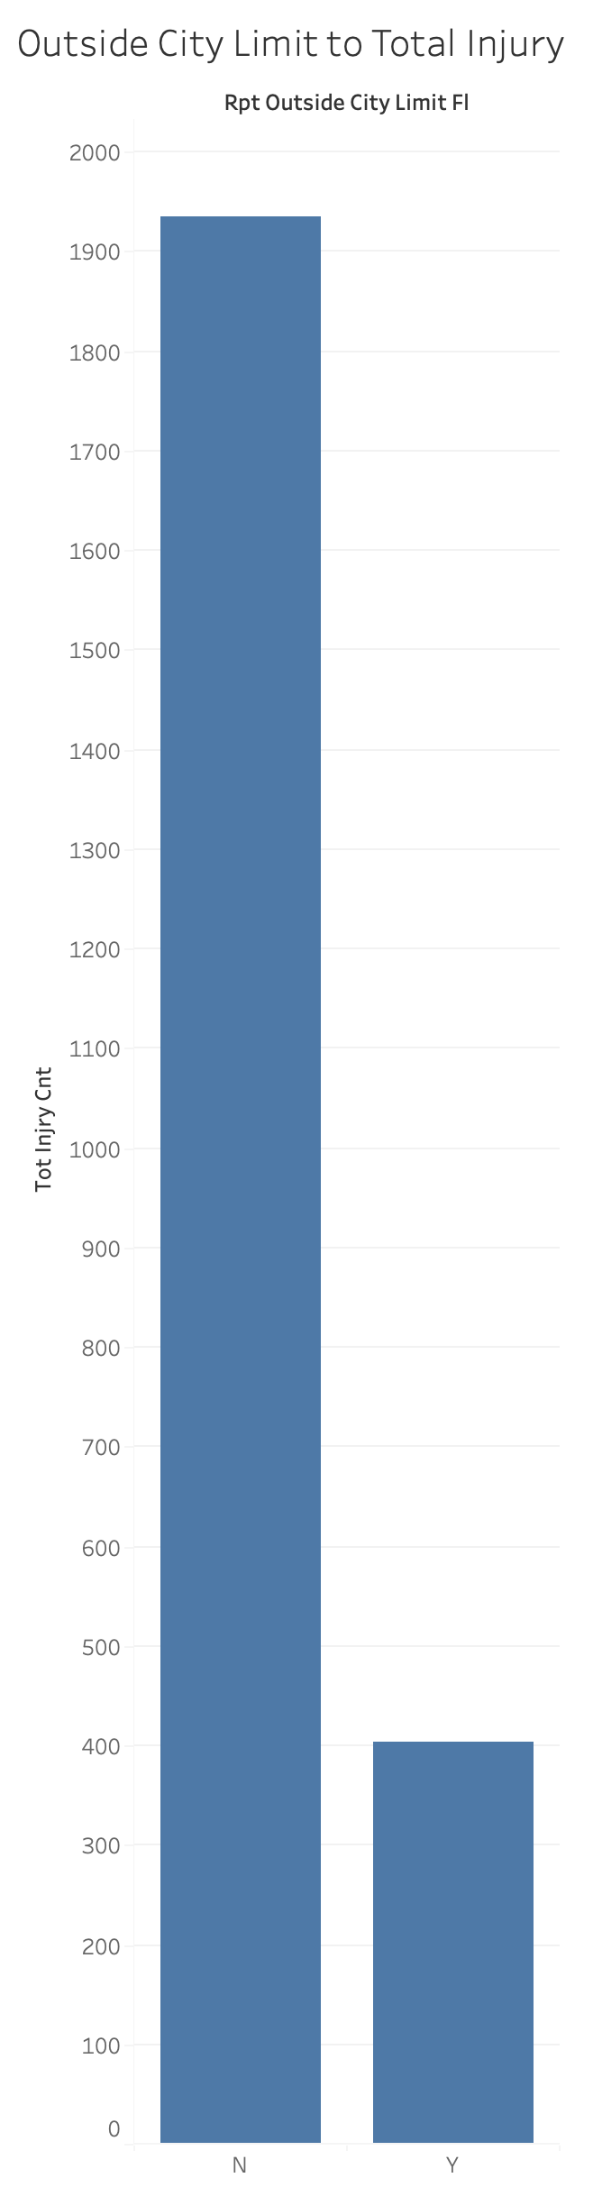
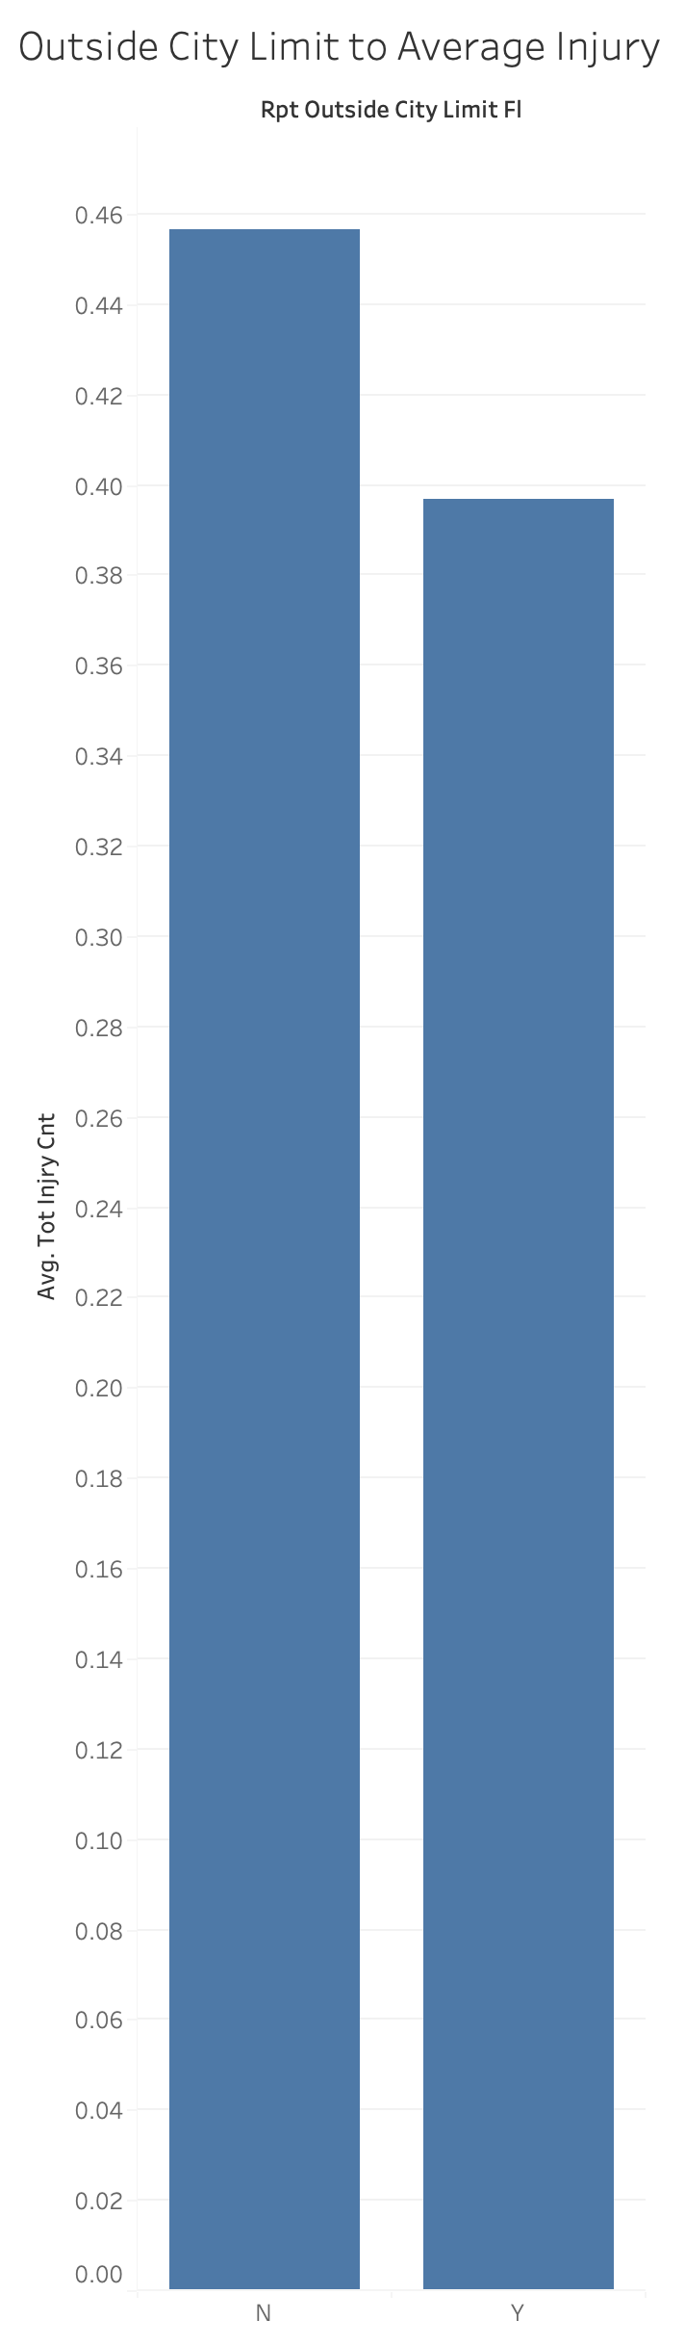
City v. Rural Crashes
More fatalities occurred within city limits
However, this is because most crashes also occurred inside of city limits. When accounting for percent of total reports, crashes outside of city limits had a higher percentage rate for fatalities.
Most injuries also occurred within city limits.
Injuries averages maintained a lower average outside of city limits. The difference between average fatalities and average deaths outside of city limits is likely due to increased speeds outside of city limits.
1.3 %
45.6%
39.7%
0.5 %

Slide 4
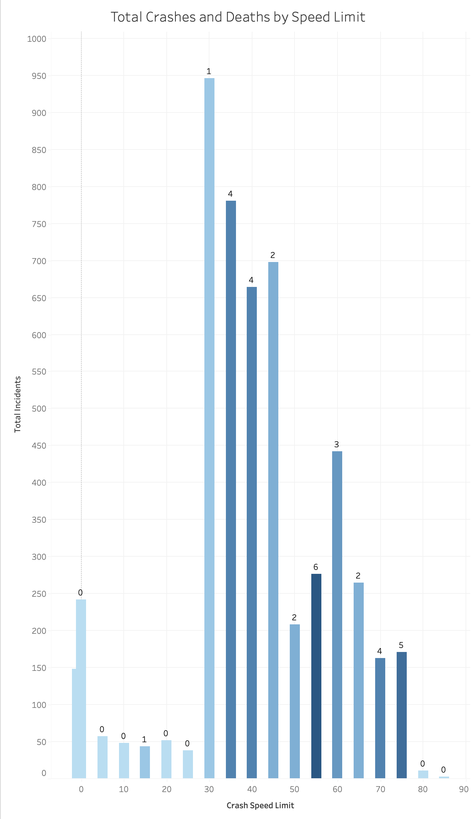
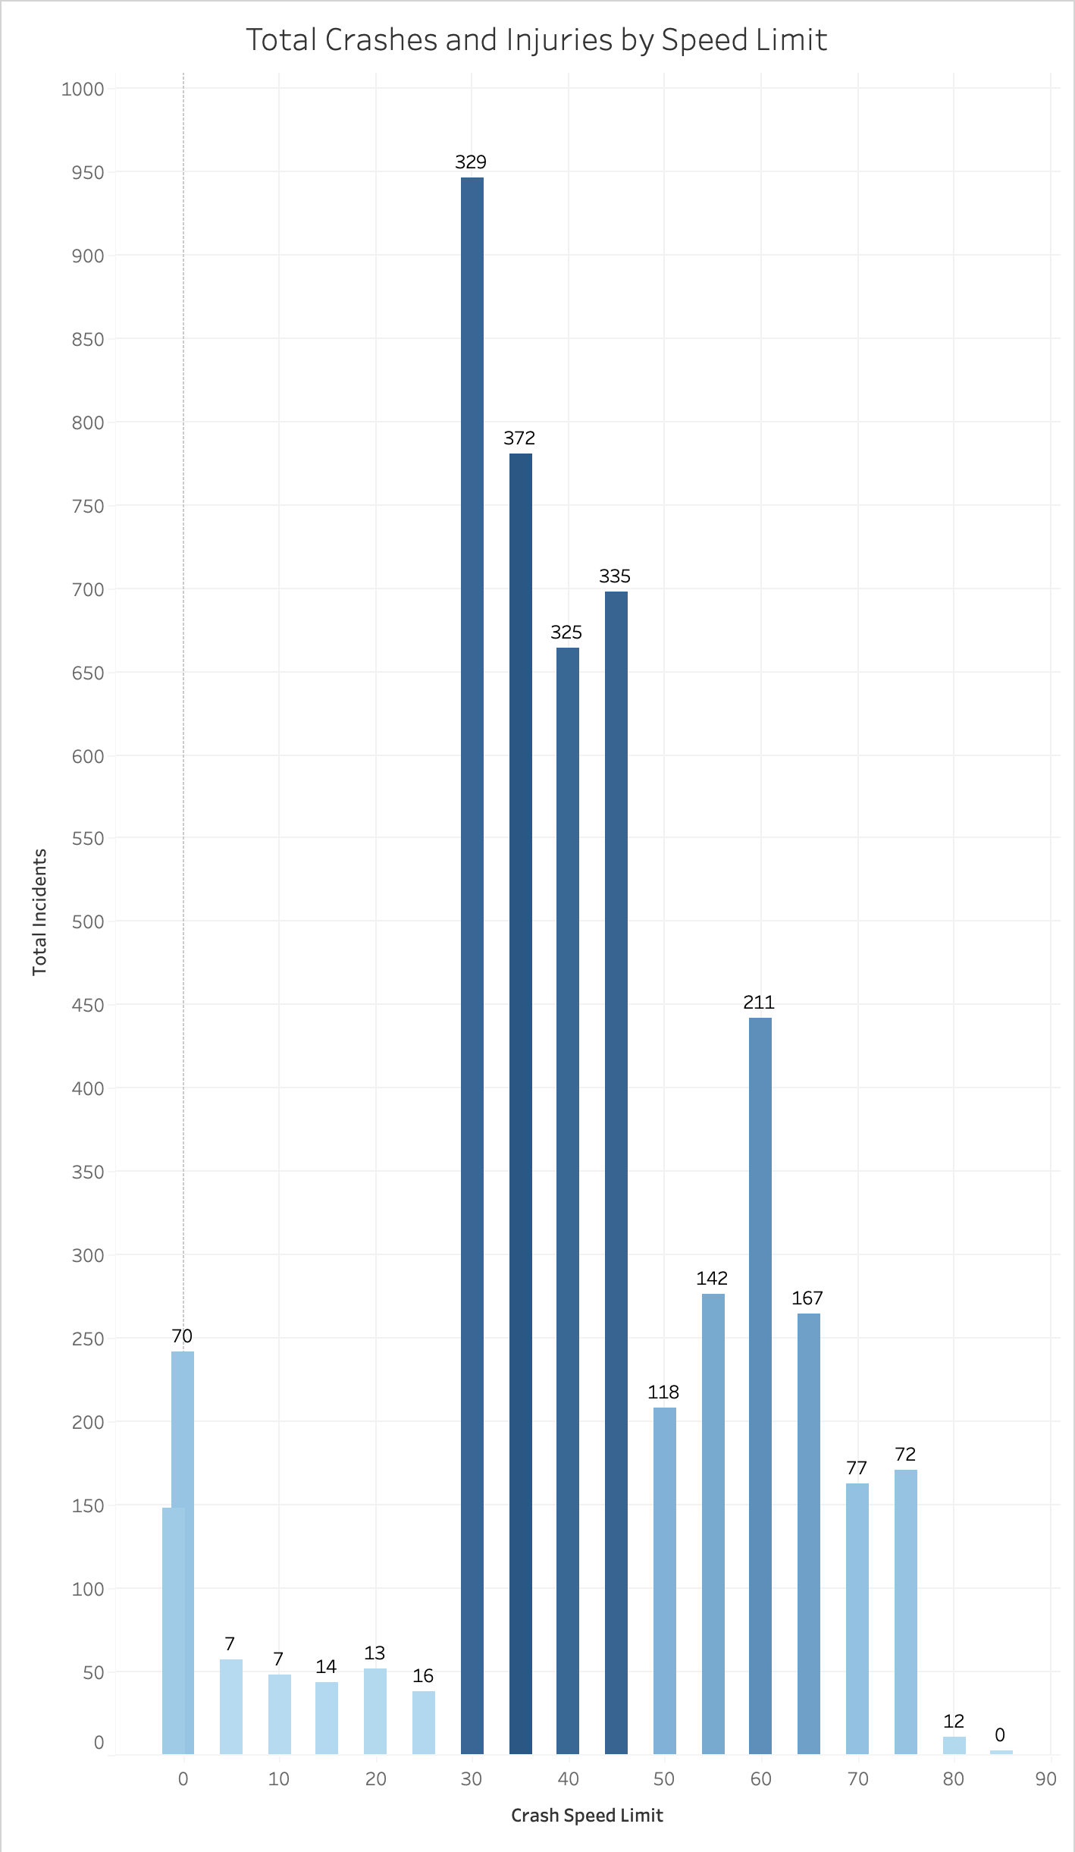
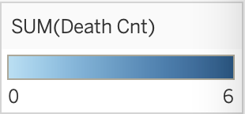
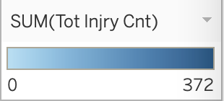
Crashes and Injuries by Speed Limit
While most crashes occur in 30 mph speed limit zones, the majority of deaths occurred in crashes with a 55 mph speed limit.
Injuries more closely aligned with total number of crashes across speed limits.

Slide 5
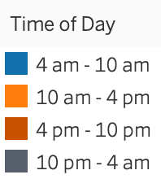
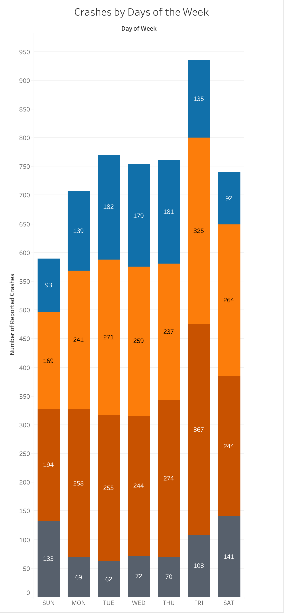
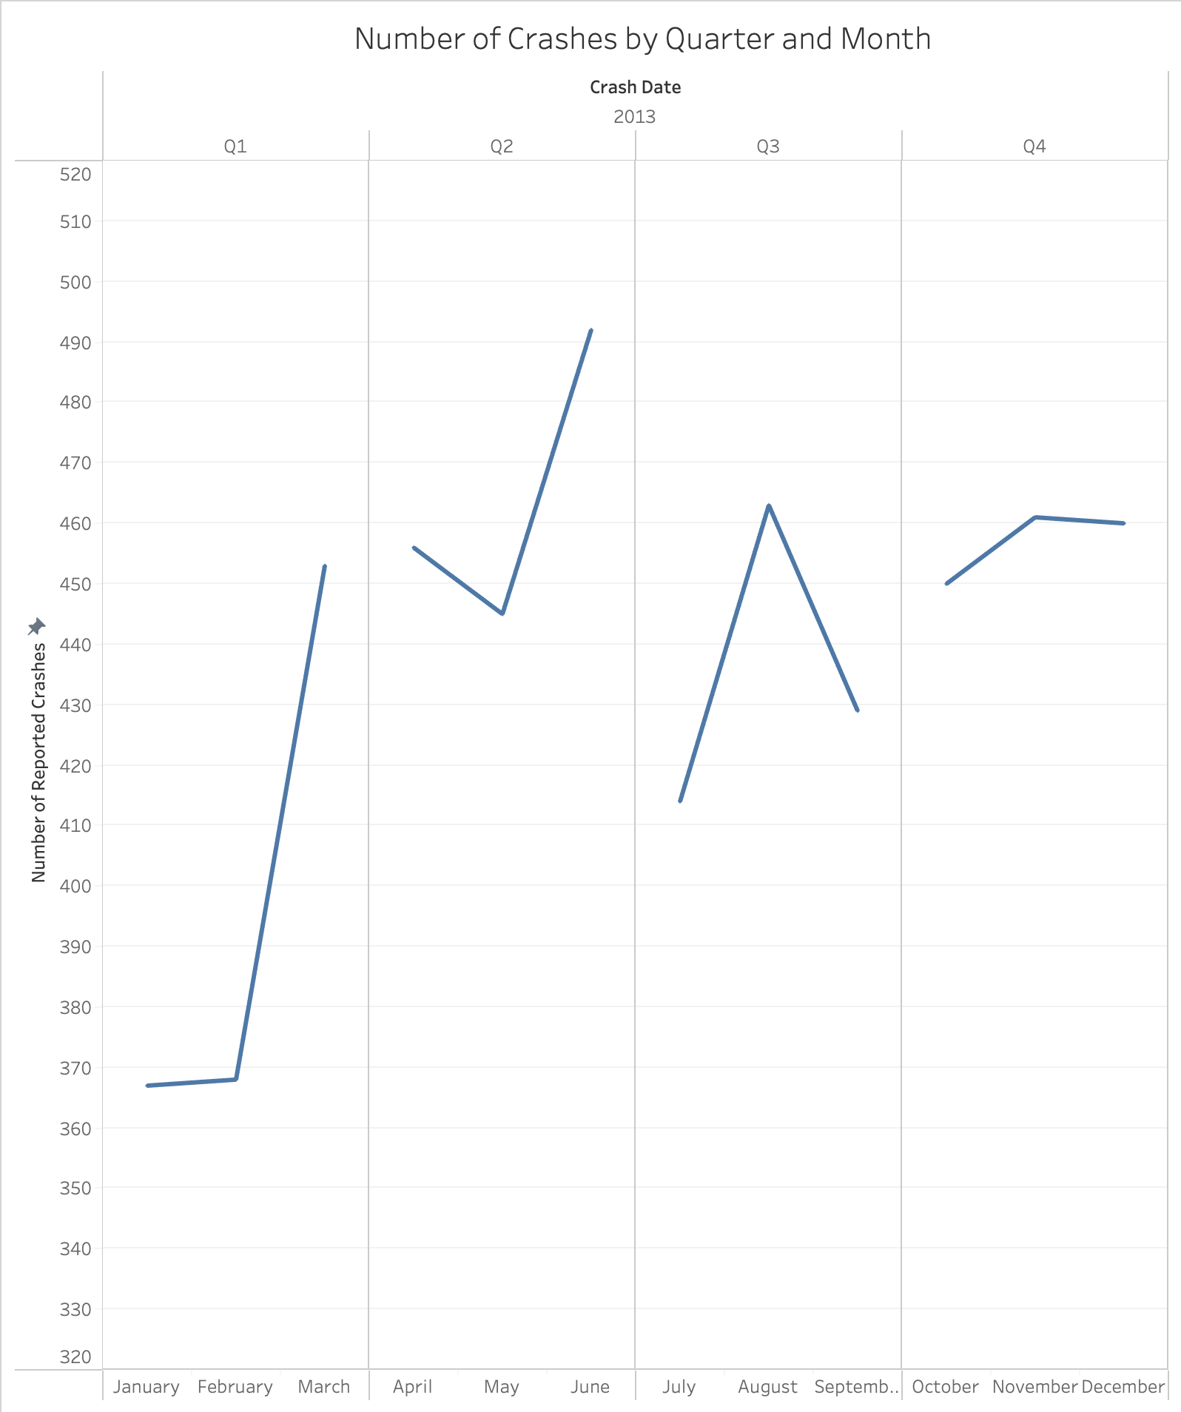
When Do Most Crashes Occur?
June sees the highest number of crashes. This aligns with the start of summer break and travel season.
Lowest amounts of crashes are in January and February, months with no holidays that see a lot of travel.
Friday sees the highest number of crashes, with most occurring during 4 pm -10 pm on Friday evenings. The next largest group occurs during Friday mid-day from 10 am – 4 pm. It looks like most crashes occur as people are trying to get home from work or go out of town on Fridays.

Slide 6
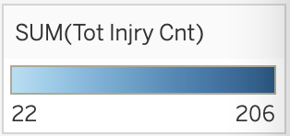
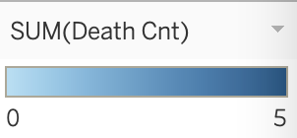
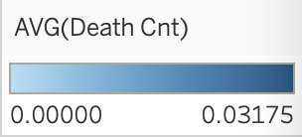
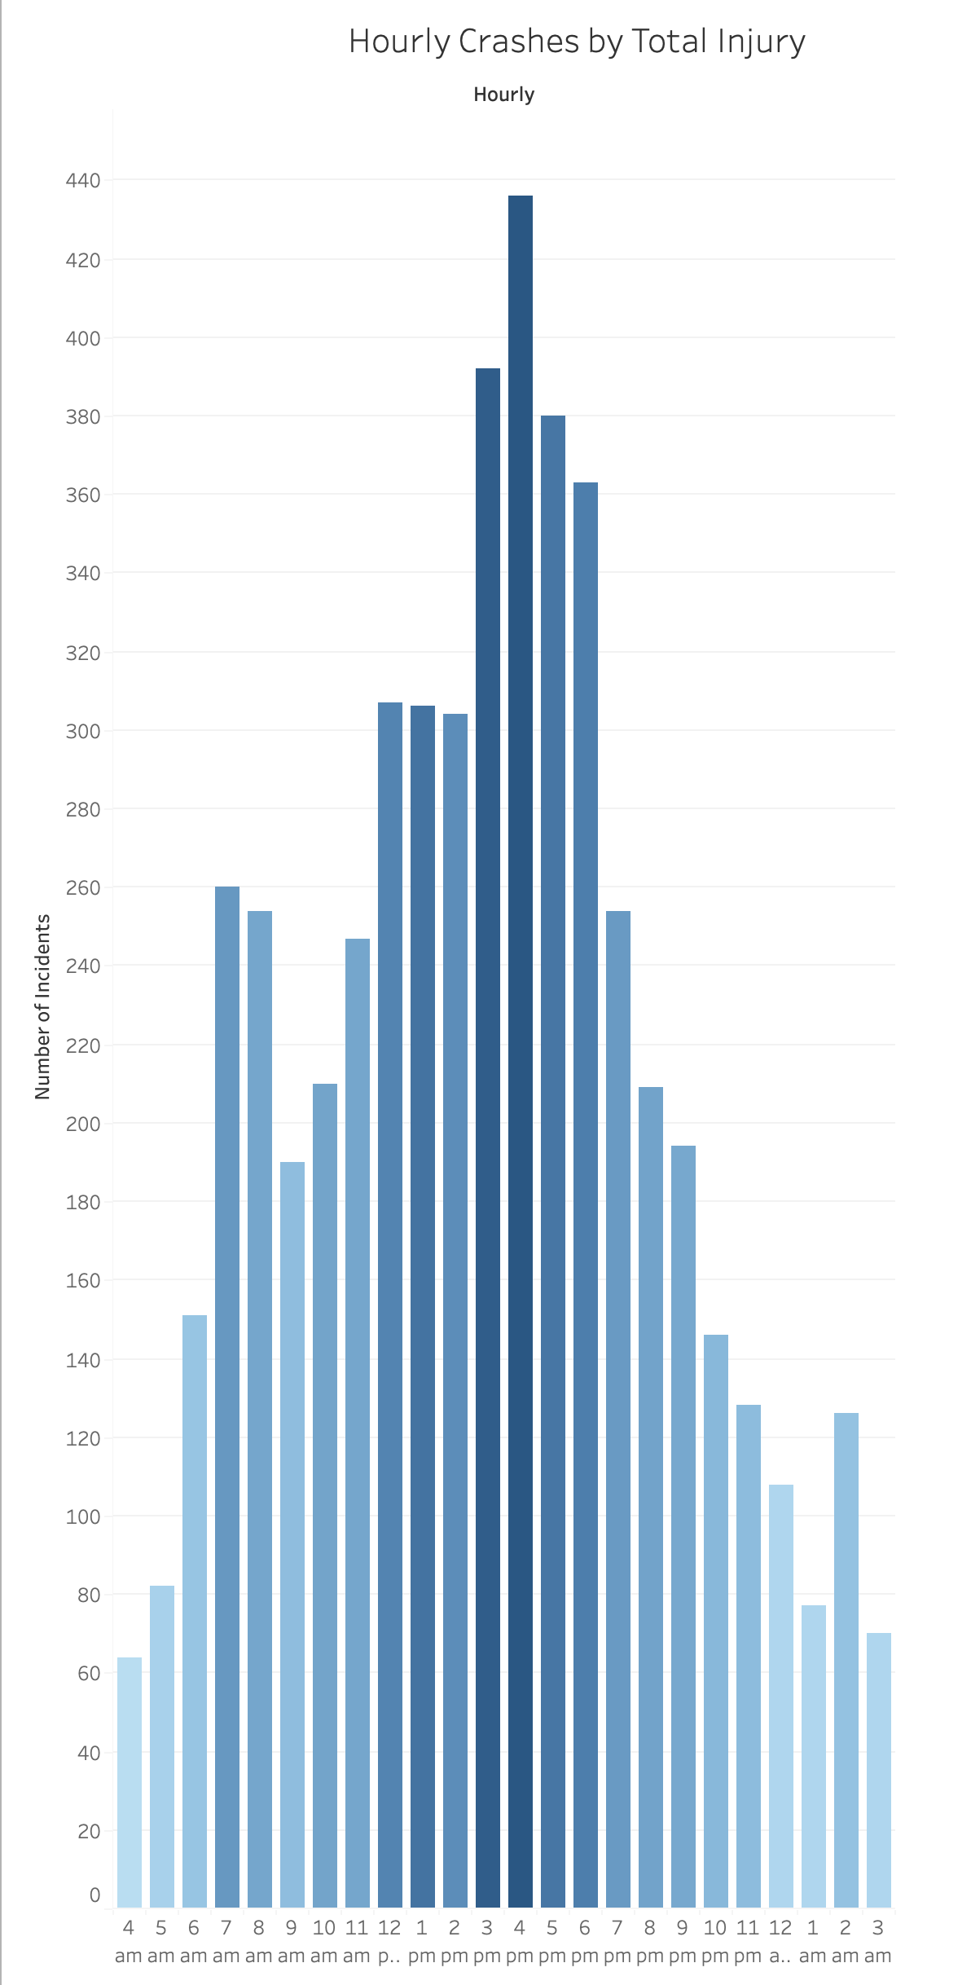
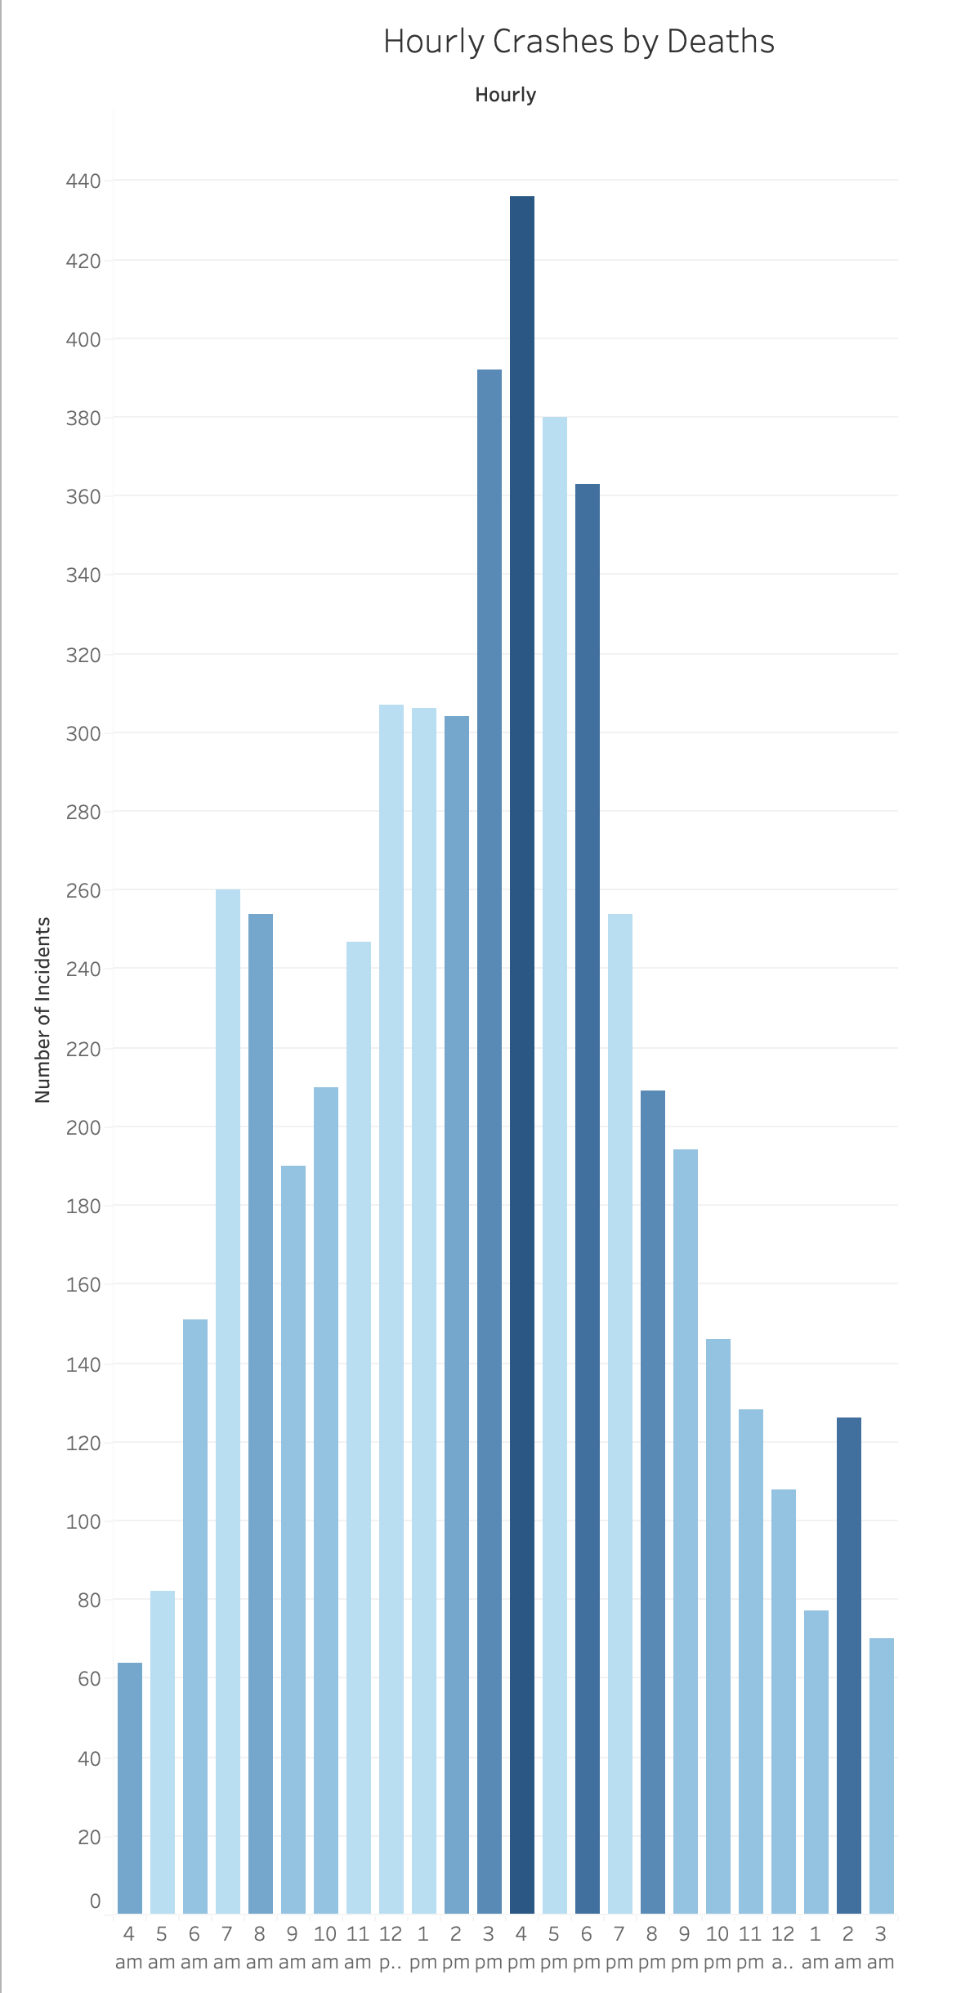
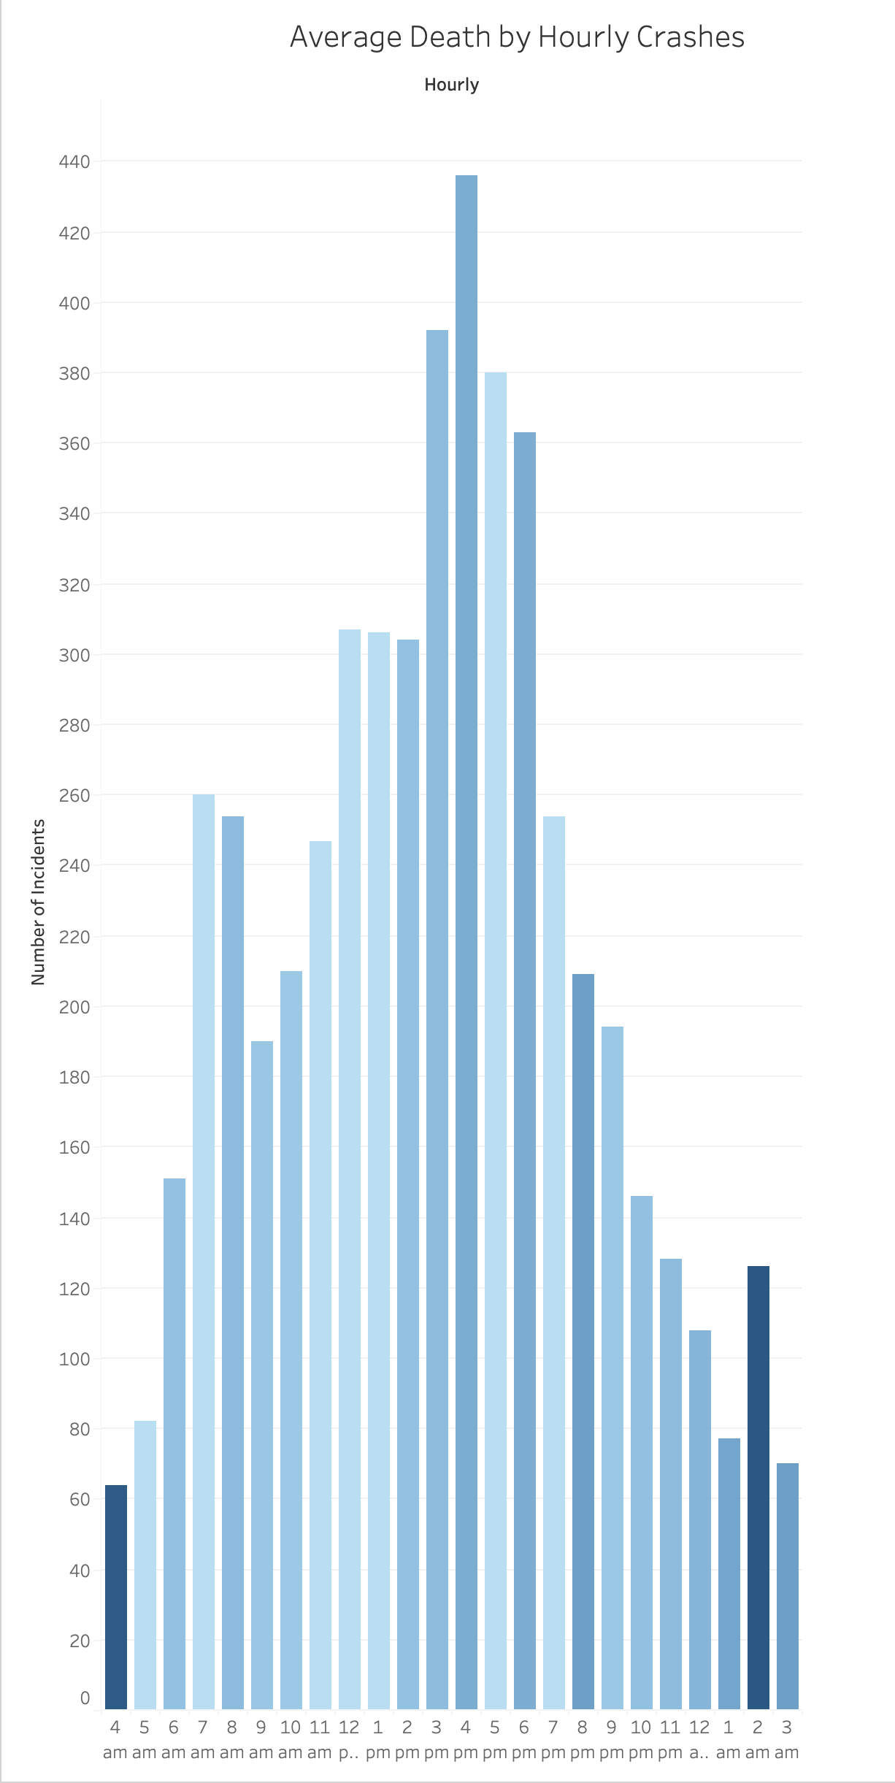
Hourly Crash Data
While the majority of both crashes and injuries occurred during the hours of 3 pm and 4 pm
A larger percentage of crashes for each hour with fatalities occurred during the hours of 2 am and 4 am.
So while there are less accidents, likely because of less people on the road, there was a higher percentage per wreck that there would be a fatality.
And the majority of deaths occurred during the 4 o’clock hour

Slide 7
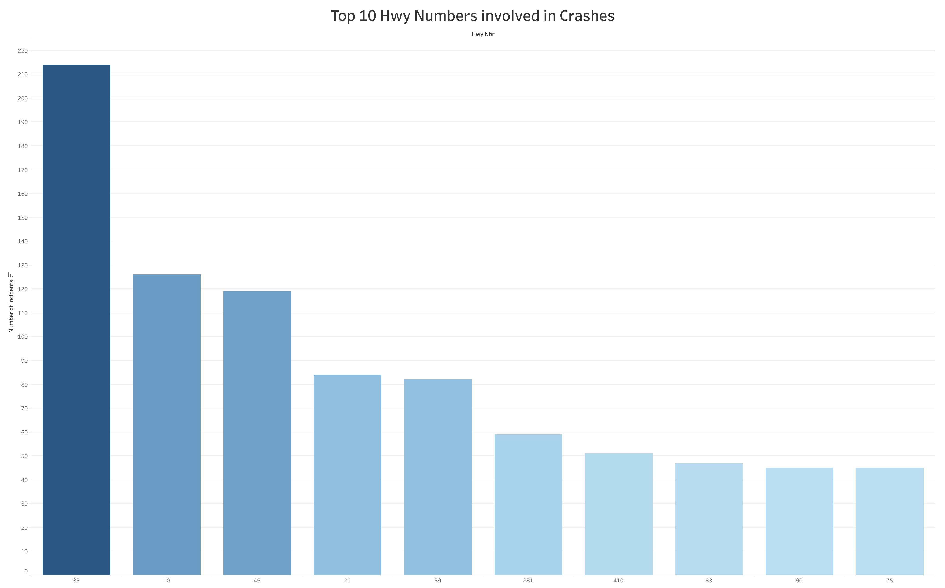
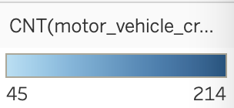
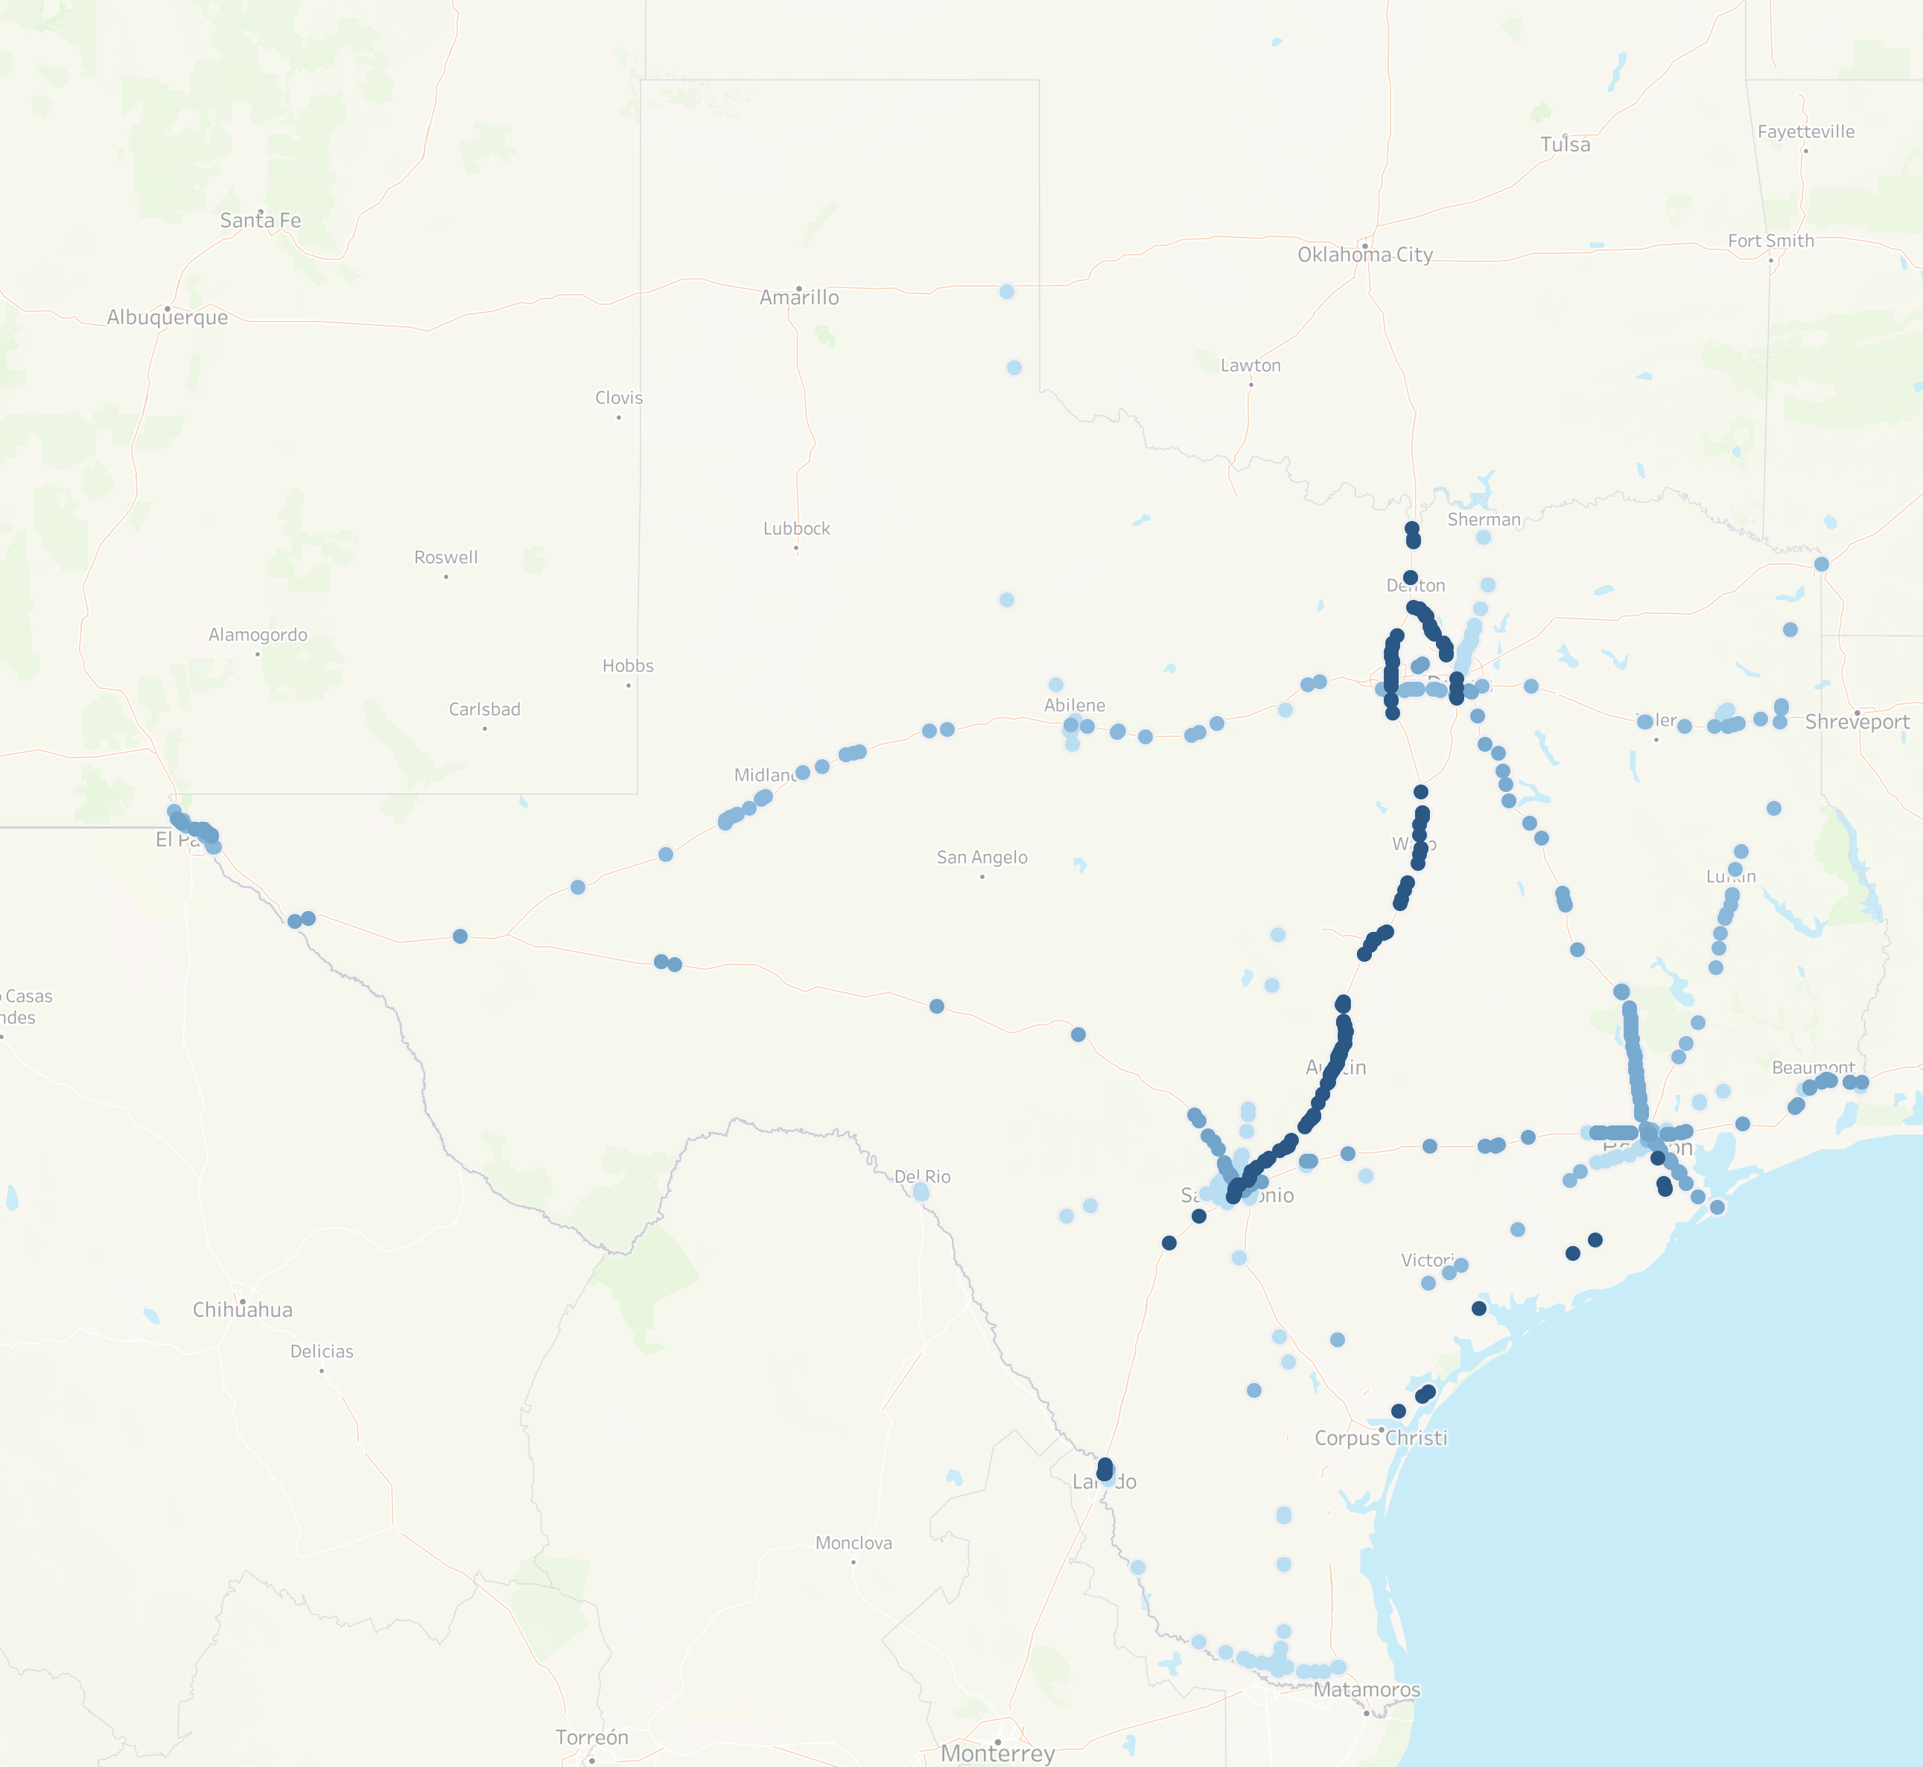
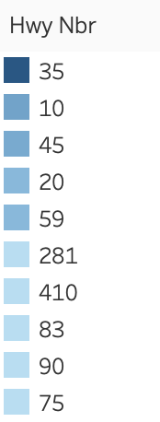
Most Problematic Highways
The highway that was the location of the highest number of accidents was Highway 35
The majority of this highway lies along the route between Dallas/Ft. Worth and San Antonio.
This is not the longest roadway, but likely has a good deal of traffic between the two large cities.

Slide 8
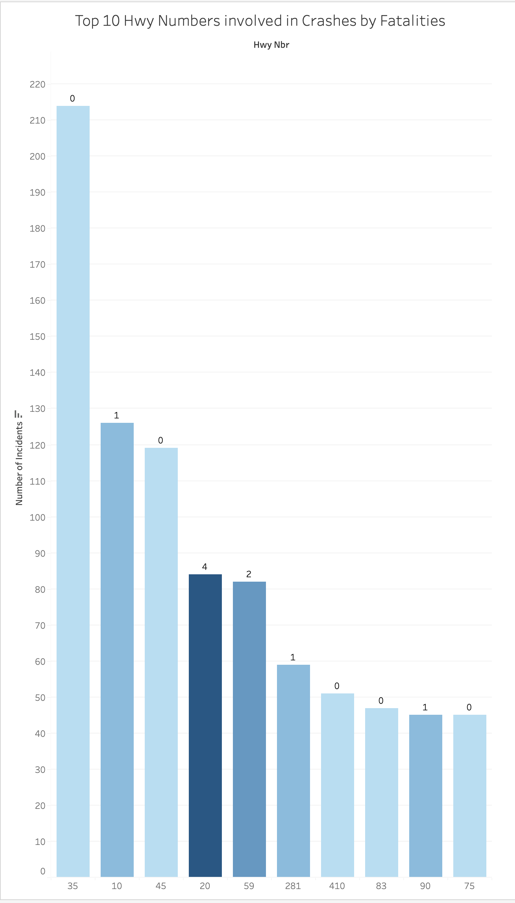
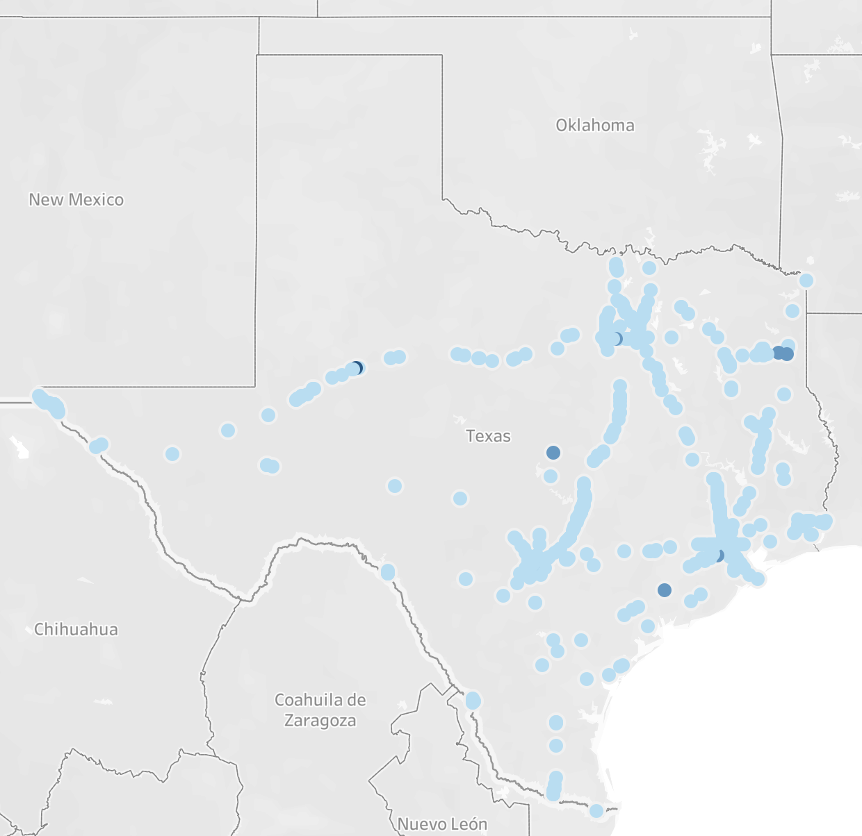
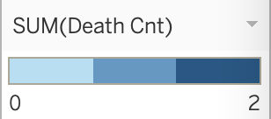
Deadliest Highways
While Highway 35 had the most incidents, it had 0 fatalities.
Highway 20 had the highest amount of fatalities over any other highway.

Slide 9
Takeaways
The state of Texas might consider focusing strategies:
Assessing the to see if the amount of traffic on Hwy 20 is leading to increased number of accidents, or if there are other factors that make this stretch of road more problematic than other highway systems.
Reducing the speed limits on roads outside of the city that appears to be influencing fatality rates.
Addressing congestion concerns that might be contributing to an increased amount of accidents on Fridays.

